Slide 1
Technical Writing & Presentation Skills
Reference & Citation

Slide 2
How to cite sources?
References
A reference list is a list of the resources that you used when writing your assignment or doing your research. These resources may include:
Books, including electronic books, journals (online an paper based), online sources including websites, blogs and forums, speeches, personal communications, conference papers, proceedings, theses and other sources of information such as film, television, video, etc.
Reference lists come at the end of an assignment, and are arranged in alphabetical order, usually by author or editor. If there isn’t an author or an editor, the title is used.

Slide 3
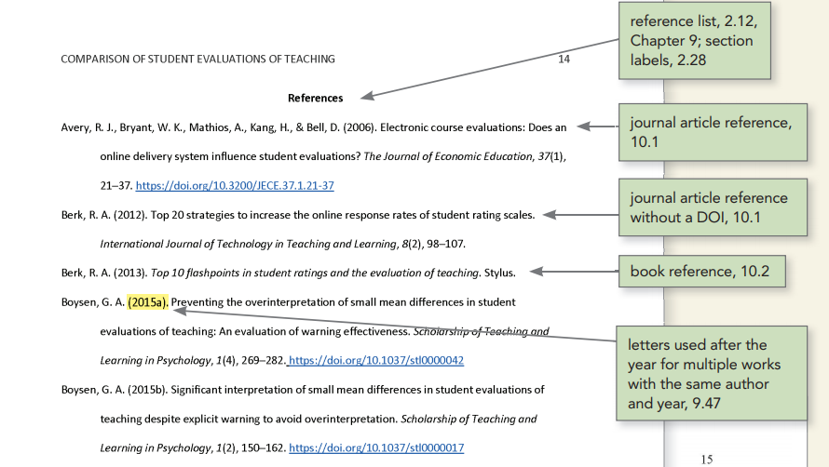

Slide 4
How to cite sources?
Citations or in-text citations are similar to references, but occur in the body of the text with direct quotes and paraphrases to identify the author/publication for the material you have used. In other words, we can say this is a list of the sources you have cited.
Citations are used:
For direct quotes – when you repeat a passage from a text (or speech, video, etc.) in your assignment without changing any words.
When you paraphrase – this is when you use your own words to restate the meaning of a text in your assignment.

Slide 5
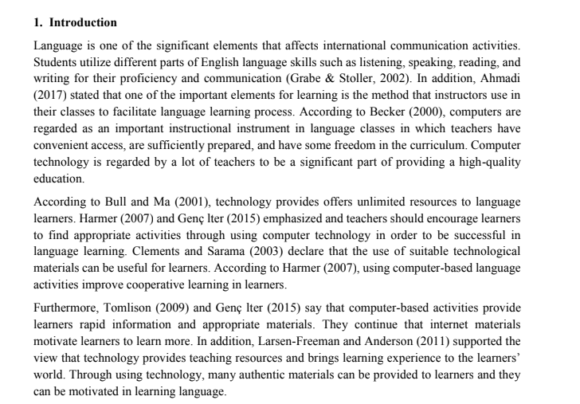

Slide 6
Referencing style
There are many different ways of citing resources. The citation style sometimes depends on the academic discipline involved. For example:
APA (American Psychological Association) is used by Education, Psychology, and Sciences https://apastyle.apa.org/
MLA (Modern Language Association) style is used by the Humanities
Chicago/Turabian style is generally used by Business, History, and the Fine Arts
Vancouver is used in medicine and the natural sciences, and sometimes in technology.

Slide 7
American Psychological Association (APA)
GUIDELINES:
These guidelines will help you write the different elements of Works Cited entries correctly.
Authors
All authors' names are written last name, comma, first initial, and then a period.
John, K. OR Javed, U. OR Asif, R
If there is more than one author, include a comma and an ampersand (&) between the names.
Balente, J., & Everett, G. OR Asif, R., & Mehmood, F.

Slide 8
American Psychological Association (APA)
If there are more one author, cite the first and then write “et al.”
Last, F.M. et al.
Siddiqui, M.R. et al.
If there is no author listed, you may use a group or organization as the author. If there is no author at all, move the title to first position.
Centers for Disease Control.
Note: You only need to provide initials for the first and middle names, but do include initials for all middle names provided by the source.

Slide 9
American Psychological Association (APA)
Dates of Publication
Dates of publication should be placed in parentheses after the author. For most sources, just a year is sufficient, but for newspaper and magazine articles, days and months should be listed after a comma following the year.
(2006).
(2006, May 6)
Titles
Titles should be formatted in either italics or plain text, and the use of capital letters varies.

Slide 10
American Psychological Association (APA)
Journal Articles:
Include the full journal title, using upper and lowercase letters. The journal title is italicized. Follow the journal title with a comma.
Volume and Issue Numbers:
Volume and issue numbers are required for journal article. List them with numeral only, no abbreviations. Volume numbers should be italicized and issue numbers are placed in parentheses. An article from volume 53, issue 7 of a journal would be
53(7),
Page Numbers
Page numbers are written with numerals only, no abbreviations, on the reference list.
67-72.

Slide 11
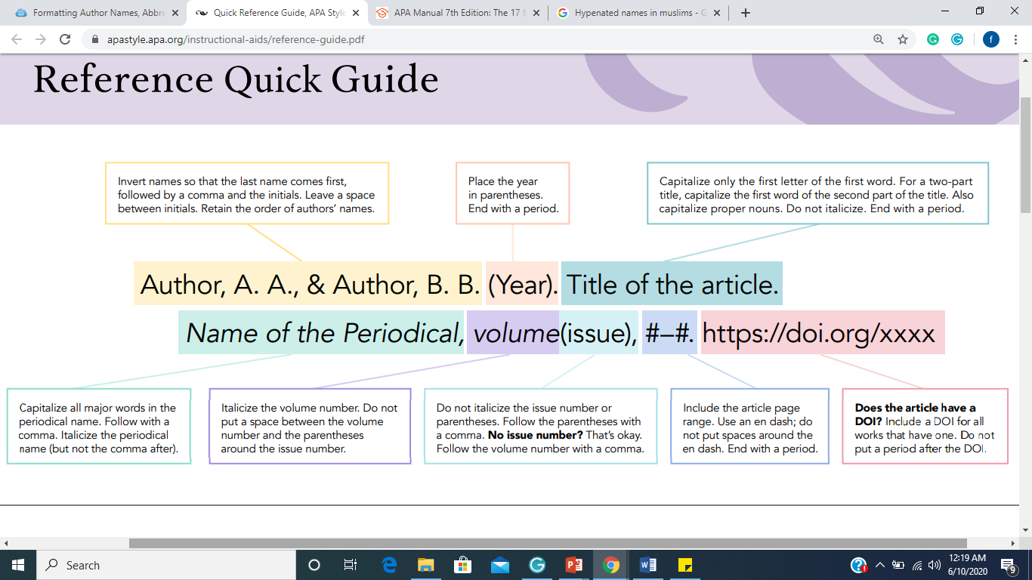

Slide 12
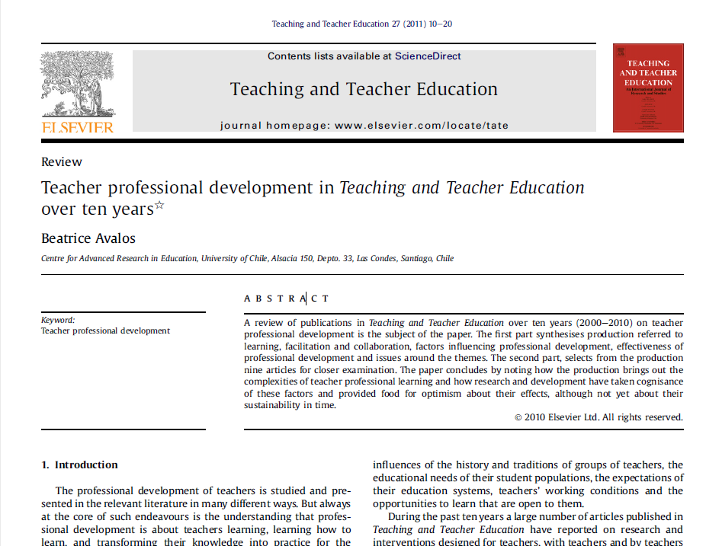

Slide 13


Slide 14


Slide 15
American Psychological Association (APA)
For books:
Author Year Title (Edition) Publisher DOI/URL
Publishers
Write the name of the publisher given on the title page. You may shorten the publisher, for example, using "Knopf" for Alfred A. Knopf, Inc.
Oxford University Press.
Cambridge.
Knopf.
Editor/Editors
Write the word “In” and the initials and last name of each editor. Use “(Ed.)” for one editor or “(Eds.)” for multiple editors. End with a comma.
In A. A. Editor & B. B. Editor (Eds.),
Chapter in an Edited Book

Slide 16
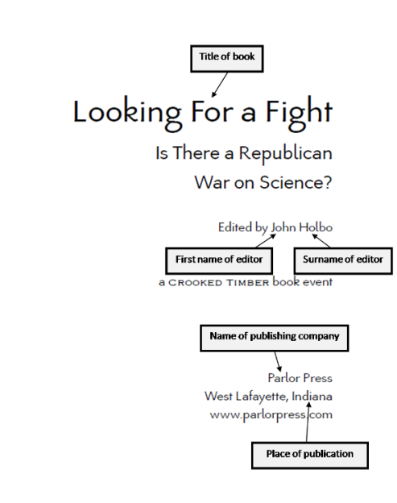

Slide 17
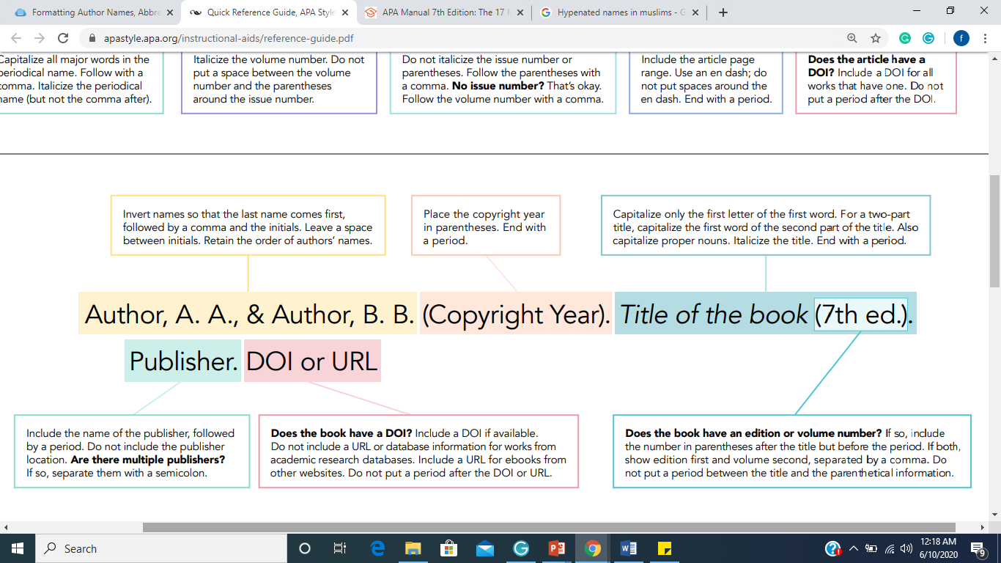

Slide 18
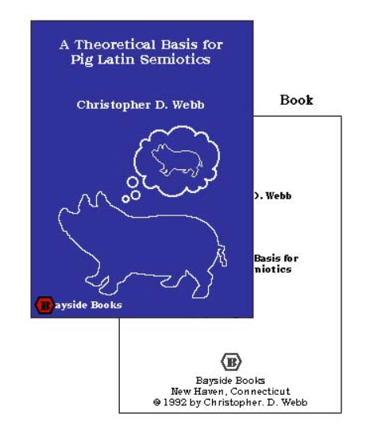
Reference Style BOOK

Slide 19
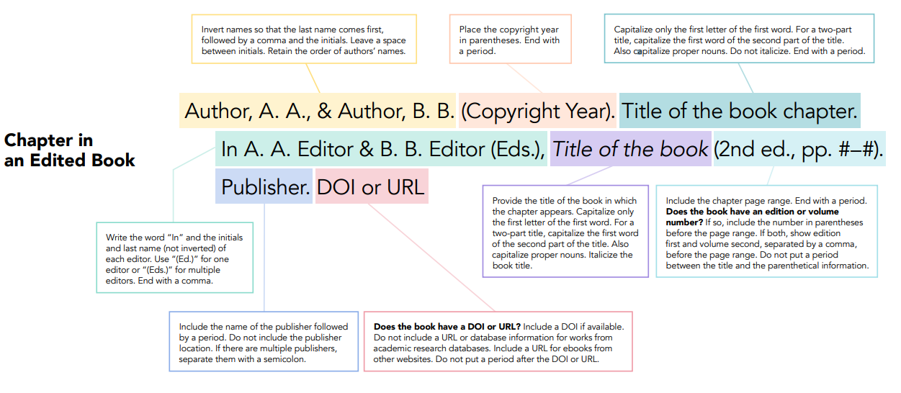

Slide 20
Write the information in a APA format
Rewrite the given information in APA style:
Book title: Focus on the learner: pragmatic perspective for the language learner
Book Author: Noam Chomsky
Editors: John W. Oller & Jack C. Richards
Publisher: Newbury House publisher
Date: 1973

Slide 21
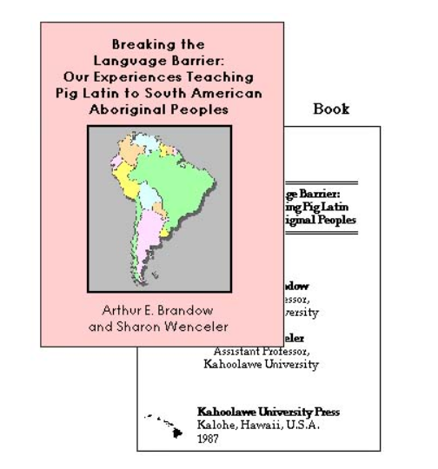


Slide 22
Practice
Rewrite the given information in APA style:
An article in the journal: Applied linguistics. It was written in 1985 by E Bialystock and M Sharwood-Smith. The title of the article is: Interlanguage is not a state of mind. It was published in volume 6 and it is from page 101 to page 117.
A book by Lyle Bachman and Adrian Palmer written in 1996. The title is: Language testing in practice. It is published by Oxford University Press in Oxford.
An article by Robert Cooper called: What do we learn when we learn a language? It was published in 1970 in the journal TESOL Quarterly. It is on pages 303-314 in volume 4.

Slide 23
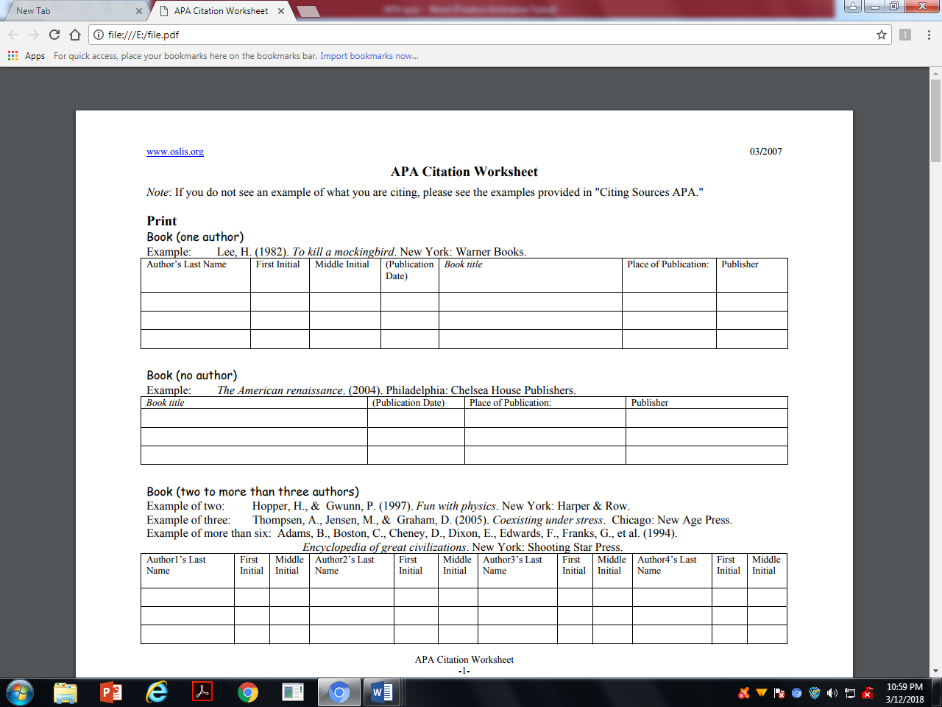
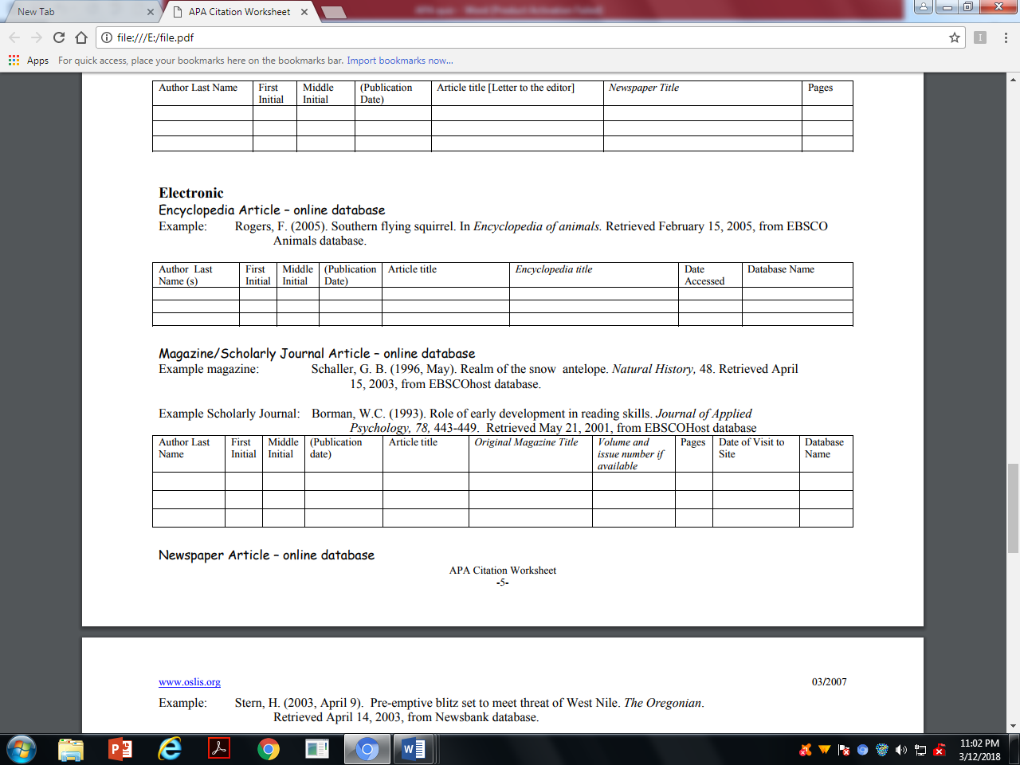
Practice
Fill in the box:
To kill a mockingbird. Lee, H. (1982). New York: Warner Books
Borman, W.C. (1993). Role of early development in reading skills. Journal of Applied Psychology, 78, 443-449. Retrieved May 21, 2001, from EBSCOHost database

Slide 24
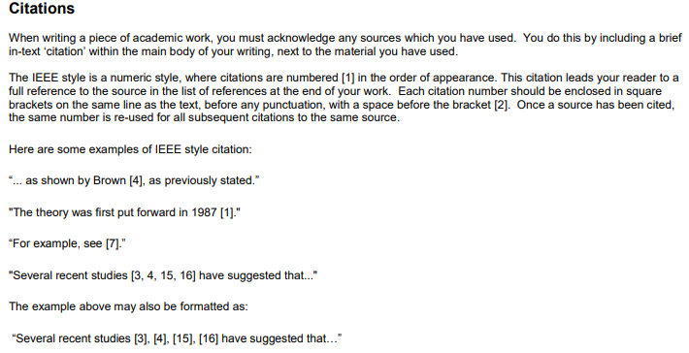
IEEE style

Slide 25

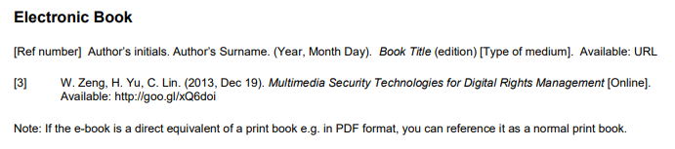
IEEE style

Slide 26
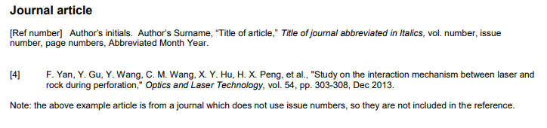
IEEE style

Slide 27
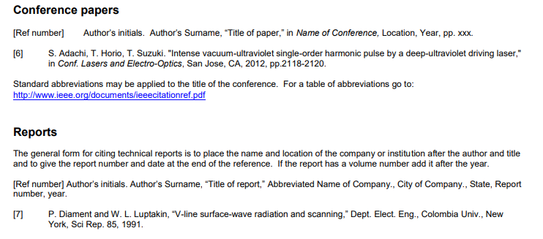
IEEE style

